Slide 1
CURRENCY CONVERTER
Minor Project

Slide 2
Sushila Devi Bansal College of Engineering, Indore
Internal Guide
Guide Name
Associate/Assistant Professor
Department of Computer Science and Engineering
Project Team Members
Name:- Enrollment No:-
Abhimanue V.B. 0834CS191002
Hitesh Bisht 0834CS191028

Slide 3
INTRODUCTION
A currency converter is useful in converting and checking the values of
international currencies. User may use this website to convert value of any currency into the relative value of other currencies.
Currency conversion is of practical use to tourists who travel abroad, to businesses who do business overseas or are involved in imports and
exports and to FX traders. The universal currency converter was made
as a tool in order to help those kinds for the quick conversion of any
currency into any other currency.

Slide 4
PURPOSE
This web tool can be used in conversion from currency to currency.
While converting, the user is provided with the ability to add or take out any currency they want from the list.

Slide 5
EXISTING SYSTEM
One may say they can convert any currency with an easy google search. But
you notice that you have to select currencies again and again. There is no way you can compare between more than two currencies in that system.
Therefore…
PROPOSED SYSTEM
The user may use our web tool that can show conversions of multiple
currencies at once; plus they can choose what currencies should there be on
the list and what should be not there.

Slide 6
SCOPE
The scope of this project is to provide the user the best
experience, with lesser distraction and better efficiency while they are attempting the conversion.

Slide 7
REQUIREMENTS SPECIFICATION
Software Requirements
HTML
CSS
JavaScript
Hardware Requirements
Processor: Intel Pentium 4
Hard Disk: 10GB
RAM: 1GB

Slide 8
TECHNOLOGY USED
HTML
The HyperText Markup Language or HTML is known as the skeleton of a web page. It is used to create the base structure of a web page and its content.
CSS
The Cascading Style Sheets or CSS is the language that we use to style an HTML document. CSS has the responsibility to describe how HTML
elements should be rendered on the screen.

Slide 9
TECHNOLOGY USED
JAVASCRIPT
JavaScript exists along with HTML and CSS. Using this language, programmers can create dynamic and interactive web content. It is used as a client-side
programming language by 97% of all the websites.

Slide 10
TECHNOLOGY USED
IDE (Integrated Development Enviromnent)
VS Code
Visual Studio Code is a free, built on open source, text editor to code;
developed by the Microsoft Corporation for programmers which
supports macOS, Linux and Windows.

Slide 11
SYSTEM ARCHITECTURE
Start
Displays a list of currencies
An option is provided where
user can add other currencies from another list
Converts value the moment it is added
Stop

Slide 12
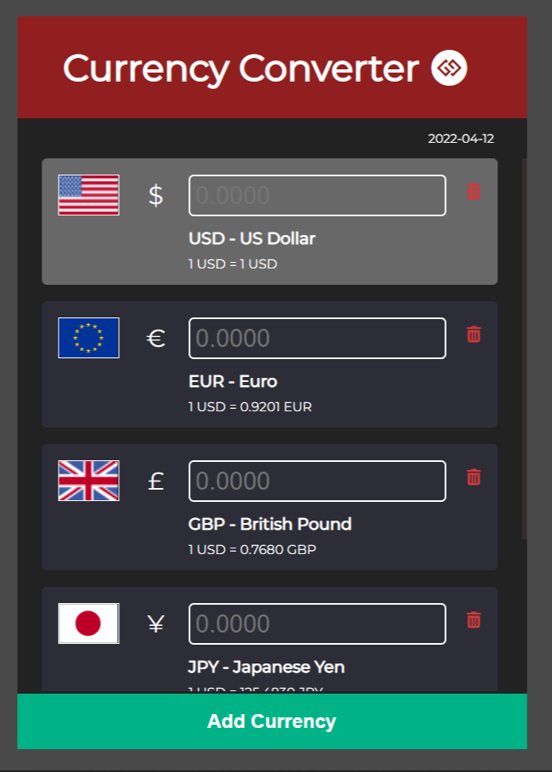
OUTPUT SCREEN
This is the main screen of the website. You can see several currencies are displayed.

Slide 13
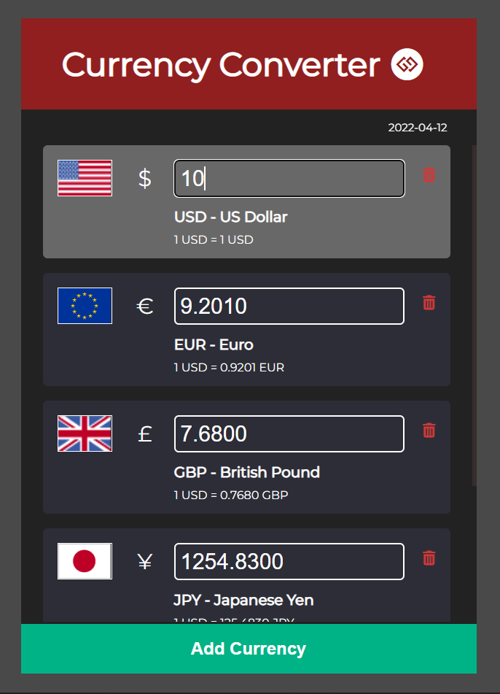
OUTPUT SCREEN
The current screen is the output after entering the value of USD and it is converted into other currencies already.

Slide 14
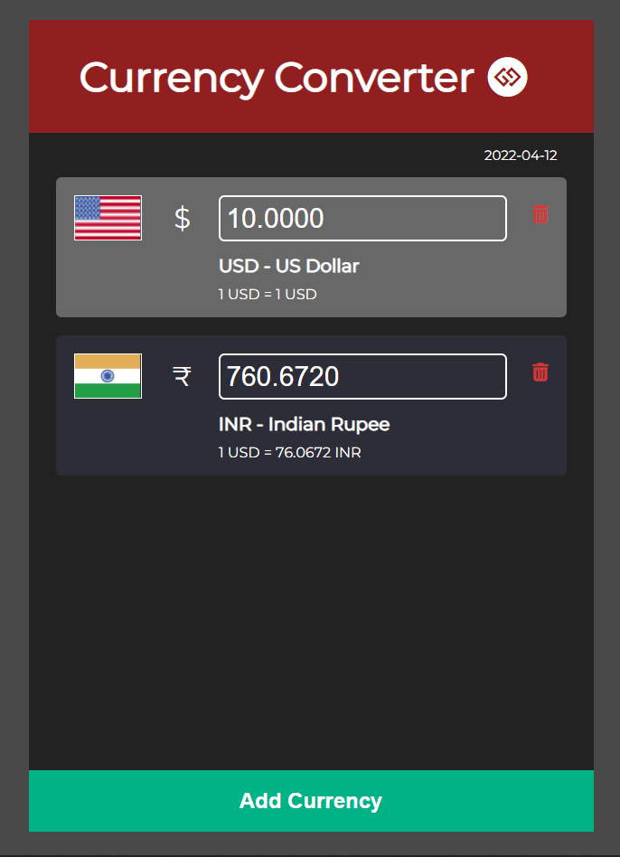
OUTPUT SCREEN
The current screen is the interface that shows that some of the currencies in the list are removed;
proving the feature of manipulation of the list.
There is a trashcan icon that represents the delete operation.

Slide 15
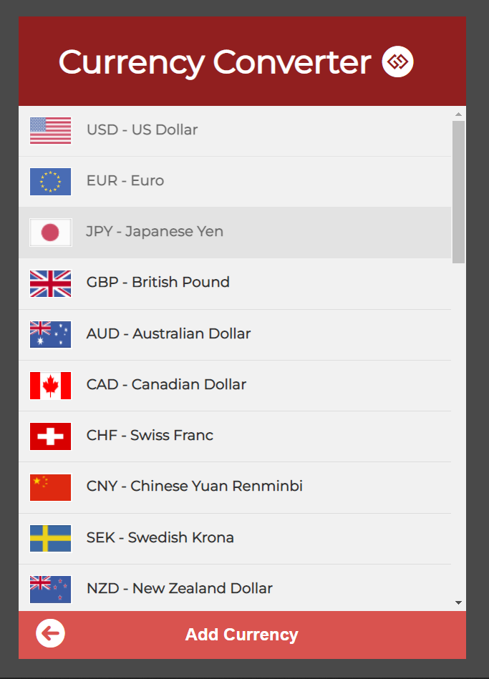
OUTPUT SCREEN
The current screen is the list of currencies that can be added on the list on the main screen,
appeared after clicking on the “Add Currency”
option.

Slide 16
CONCLUSION
Our currency converter website can be used for conversion of
international currencies. And the user can convert one currency to
multiple currencies based on the user’s interest. It has add and remove currency from the list feature, that means user can manipulate the list themselves using the given options. It was developed using web
designing languages i.e. HTML which was used to display the contents in the project, CSS which was used to create the minimalistic appearance and JavaScript which was used to create the brain and behavior of the currency converter.

Slide 17
THANK YOU

